Slide 1
DEEP LEARNING-BASED MODEL FOR SOLVING DEPENDENCY VERSION CONFLICTS
Watobiloba A. 23/3005, Badejo Olurunfunmi T. 23/2326, ASekunoWo Demilade O. 22/0668
Department of Computer Science
LANDMARK UNIVERISTY
Supervisor: Mr Alfa O. Peter

Slide 2
TABLE OF CONTENT
INTRODUCTION
PROBLEM STATEMENT
AIM AND OBJECTIVE
LITERATURE REVIEW AND GAP
METHODOLOGY
EXPECTED RESULTS
CONCLUSION
ACKNOWLEGEMENT
REFERENCES

Slide 3

01 INTRODUCTION
Software systems increasingly rely on external libraries and rameworks to accelerate development and functionality. These external components, known as software dependencies, are managed through package repositories such as PyPI and npm. While dependency reuse improves productivity, it also introduces dependency version conflicts, which occur when incompatible library versions are required simultaneously. Traditional dependency resolution techniques rely on static rules and constraint-solving methods, which often fail to scale in complex ecosystems. This project proposes a machine learning–based approach to predict and resolve dependency version conflicts using learned patterns from historical dependency data.

Slide 4
02 PROBLEM STATEMENT
Dependency version conflicts remain a major challenge in modern software development. Existing dependency management systems lack intelligence and adaptability, as they do not learn from past conflict occurrences. As software ecosystems grow larger and more interconnected, traditional resolution techniques become inefficient, leading to build failures, runtime errors, and increased maintenance costs. There is therefore a need for an intelligent system capable of predicting dependency conflicts before deployment and assisting developers in selecting compatible versions automatically.

Slide 5

03 AIM AND OBJECTIVES
AIM:
The aim of this project is to develop a machine learning-based system for predicting and resolving dependency version conflicts in software projects
OBJECTIVES:
1. To analyze patterns of dependency version conflicts in software repositories.
2. To model software dependencies using graph-based representations.
3. To design and implement a machine learning model capable of predicting version incompatibilities.
4. To evaluate the effectiveness of the proposed system using standard performance metrics.

Slide 6
04 LITERATURE REVIEW
This section reviews existing studies on dependency management, conflict resolution, and the application of machine learning in software engineering. Prior research has explored static constraint solvers, semantic versioning analysis, and graph-based dependency modeling. However, most existing approaches do not leverage deep learning models to learn compatibility patterns from large-scale dependency graphs. The identified gap is the lack of intelligent, learning-based systems that can proactively predict dependency conflicts rather than reactively resolve them.

Slide 7
05 LITERATURE REVIEW
S/N | Author | Title | Methodology | Performance | Gap
1. | Abate et al. (2020) | Dependency Solving Is Still Hard, but We Are Getting Better Results | SAT-based constraint-solving techniques or dependency resolution | Ensures correctness and completeness of dependency resolution | Does not incorporate learning or predictive intelligence for future conflicts
2. | Xu et al. (2020) | Enhancing Software Analytics with Graph Neural Networks | Application of Graph Neural Networks to software dependency graphs | Achieved better performance than traditional machine learning models | Focused on general software analytics, not dependency version conflict prediction
3. | Kikas et al. (2023) | Evolution of Package Dependency Networks | Longitudinal analysis of dependency graph evolution | Showed increasing dependency complexity over time | No intelligent system for resolving dependency conflicts
4. | Zhou et al. (2024) | Predicting Software Build Failures Using Hybrid Deep Learning Models | Hybrid graph-based and sequence-based deep learning model | Improved prediction of software build failures | Focused on build failures broadly, not version conflict resolution
4. | Wu et al. (2021) | A Comprehensive Survey on Graph Neural Networks | Survey and comparative analysis of GNN architectures | Demonstrated strong performance of GNNs on relational data | General-purpose survey; not tailored to dependency management problems
5. | Rosa et al. (2022) | An Empirical Study of Package Dependency Risks | Statistical analysis and graph mining of | Identified high-risk dependency patterns | Did not apply deep learning or predictive conflict resolution
6. | Li et al. (2022) | Vulnerability Detection with Graph Neural Networks | GNN-based modeling of software dependency graphs | Improved vulnerability detection accuracy | Focused on security vulnerabilities rather than version compatibility

Slide 8

06 METHODOLOGY
The study adopts an experimental research design. Dependency metadata will be collected from public repositories such as PyPI or npm. The data will be preprocessed to remove inconsistencies and represent dependencies as graphs. A machine learning model, potentially based on Graph Neural Networks, will be trained to predict version compatibility. The model will be evaluated using metrics such as accuracy, precision, recall, and F1-score. Python and relevant machine learning libraries will be used for implementation.

Slide 9
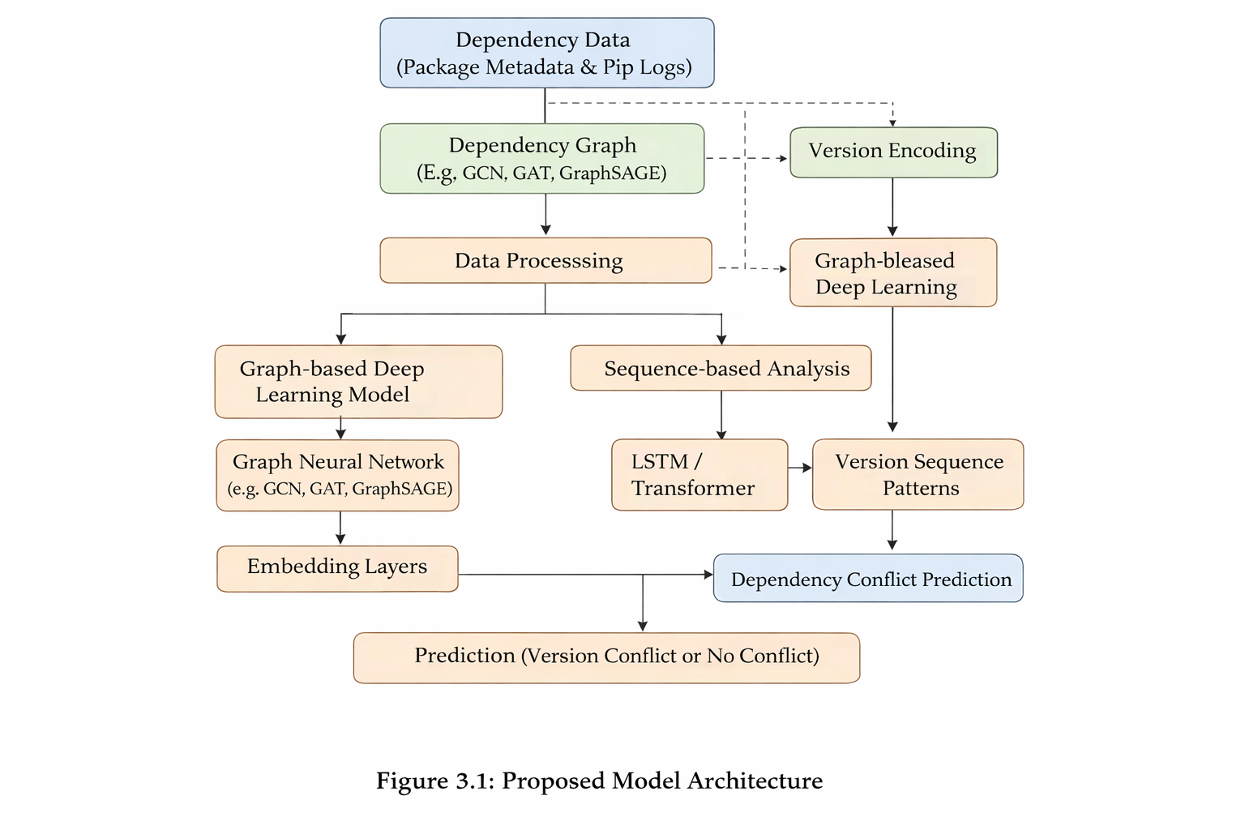
SYSTEM ARCHITECTURE DIAGRAM

Slide 10
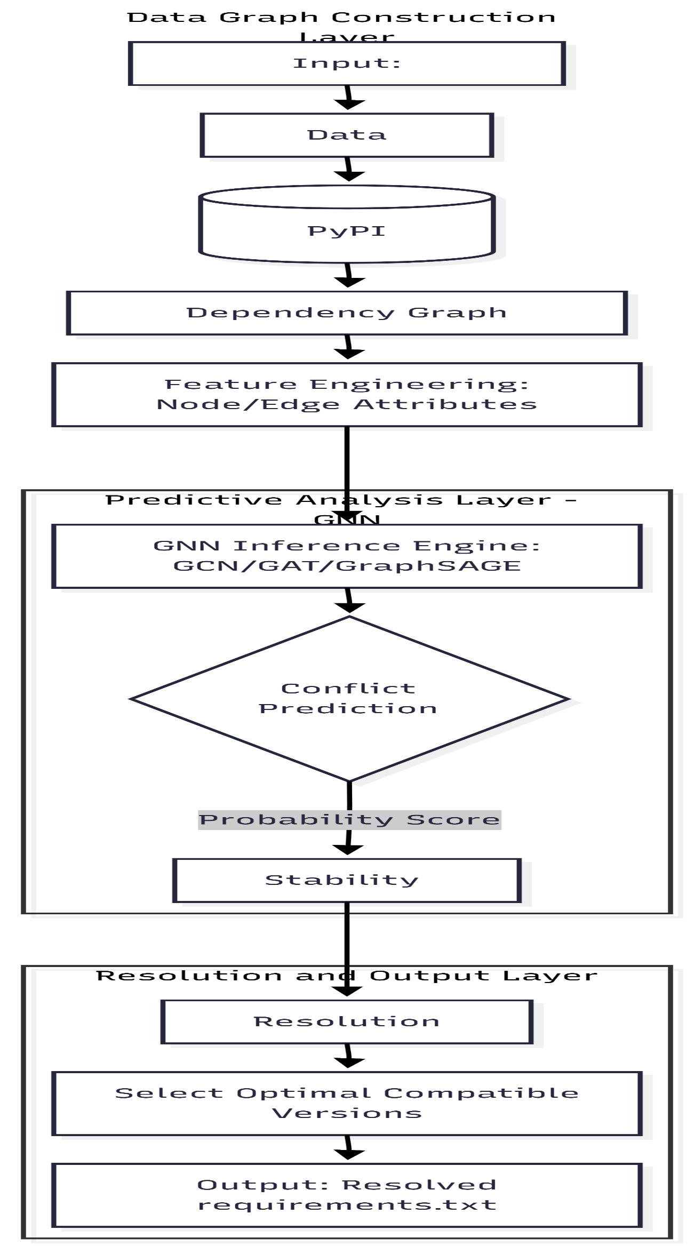

Slide 11
EXPECTED RESULTS
07
The expected outcome of this project is a system capable of accurately predicting dependency version conflicts. The proposed model is expected to outperform traditional resolution techniques by learning from historical data, reducing build failures, and improving dependency management efficiency.

Slide 12

08 CONCLUSION
This project presents a machine learning approach to addressing dependency version conflicts in software development. By leveraging learned patterns from dependency data, the proposed system aims to improve reliability and scalability in dependency management. The study contributes to the growing application of machine learning techniques in software engineering.

Slide 13

09
I express sincere gratitude to the project supervisor,Mr Alfa Peter, lecturers, and the Department of Computer Science for their guidance and support throughout the course of this project. Appreciation is also extended to family and friends for their encouragement.

Slide 14
10
REFERENCES
Kikas, R., Gousios, G., & Dumas, M. (2023). Evolution of package dependency networks. IEEE Transactions on Software Engineering, 49(2), 712–728. https://doi.org/10.1109/TSE.2022.3148296
Xu, X., Liu, C., Zhai, J., & Li, X. (2020). Enhancing software analytics with graph neural networks. ACM Computing Surveys, 53(3), 1–35. https://doi.org/10.1145/3375636
Zhou, Y., Chen, Z., & Monperrus, M. (2024). Predicting software build failures using hybrid deep learning models. Empirical Software Engineering, 29(1), 1–28. https://doi.org/10.1007/s10664-023-10315-4
Zhang, J., Wang, S., & Hassan, A. E. (2023). Software defect prediction using graph neural networks. IEEE Transactions on Software Engineering, 49(3), 1314–1330. https://doi.org/10.1109/TSE.2022.3145678
Abate, P., Boender, J., Di Cosmo, R., & Zacchiroli, S. (2020). Dependency solving is still hard, but we are getting better results. Journal of Systems and Software, 159, 110432. https://doi.org/10.1016/j.jss.2019.110432
Decan, A., Mens, T., & Grosjean, P. (2020). An empirical comparison of dependency networks in Python and JavaScript. Empirical Software Engineering, 25(4), 2921–2977. https://doi.org/10.1007/s10664-020-09813-5

Slide 15
Thank You

